Slide 1
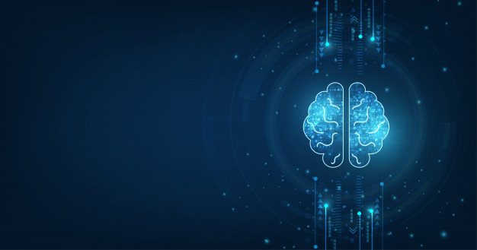


Deep Riemannian Neural Architectures for Domain Adaptation in Burst cVEP-based Brain Computer Interface
Velut Sébastien^{1,2}, Chevallier Sylvain², Corsi Marie-Constance³, Dehais Frédéric¹
1- Fédération ENAC ISAE-SUPAERO ONERA, Université de Toulouse, 10 avenue Edouard Belin, 31400, Toulouse - France
2- A&O - LISN - Université Paris-Saclay 1 rue René Thom, 91190 Gif-sur-Yvette - France
3- Sorbonne Université, Institut du Cerveau - Paris Brain Institute -ICM, CNRS, Inria, Inserm, AP-HP, Hôpital de la Pitié Salpetriere, F-75013, Paris, France

Slide 2
Introduction

Slide 3
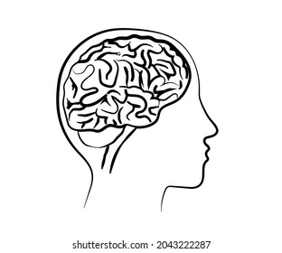
What is a Brain computer Interface (BCI) ?
Signal Processing
Preprocessing
Features extraction
Classification
Signal Acquisition
Application interface
Applications :
Spelling device
Wheelchairs
Video games
Mental state monitor

Slide 4
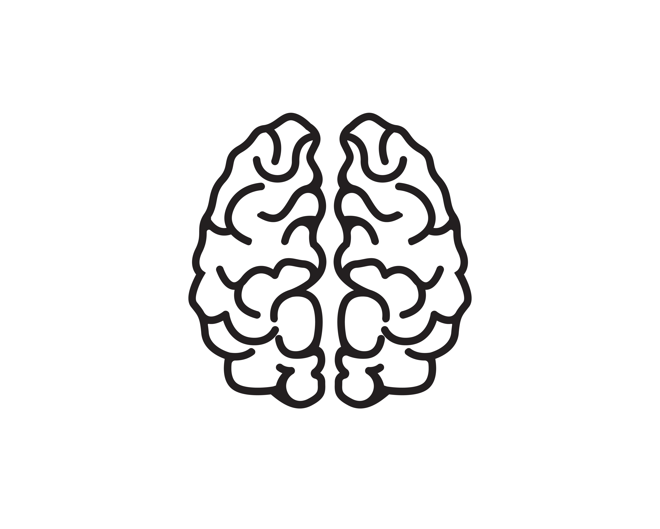
Variabilities sources
Anatomy:
Grey matter quantity
Human: way of life, education, users’ traits
Decrease in accuracy
Calibration at every usage
Discomfort in everyday usage
Physiological: fatigue, concentration, stress, circadian rhythm
Environmental condition:
Luminosity, displacement of electrodes, ambient noise
S. Saha et al. Frontiers in Human Neuroscience, page 8, 2020.
Velut, Deep Riemannian Net for DA, ESANN’24

Slide 5
Transfer Learning
Leave one out of all (LOO)
Classifier adaptation
Features adaptation
Latent tranfer learning
Optimal transport
F. Fahimi et al. Journal of Neural Engineering, page 13, 2018.
B. Aristimunha et al. NeurIPS workshop AI4Science, page 19, 2023
S. Khazem et al. IEEE/EMBS Conference on Neural Engineering (NER), page 523 2021
R. Kobler et al. In NeurIPS, 2022.
N. T. H. Gayraud et al. Graz Brain-Computer Interface Conference, 2017

Slide 6
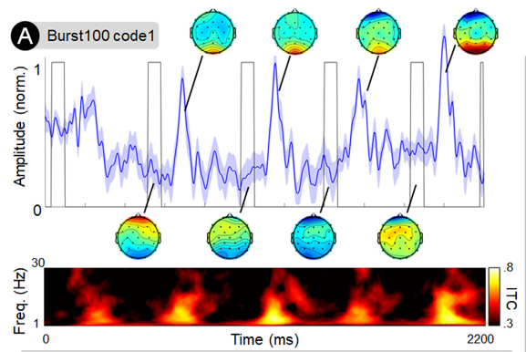
Paradigm: Burst-CVEP
Few flashes per second
(3/sec. aperiodically)
Allows bitwise decoding
Strong response
High SNR
Martinez-Cagigal et al. Journal of Neural Engineering, 2021. K. Cabrera Castilloset al. NeuroImage 2023.

Slide 7
Aim & Hypothesis
Are Riemannian Deep Learning Algorithms improving accuracy in Burst-CVEP-based BCI ?
Is it performant in a domain adaptation or domain generalization framework ?
Hypothesis
Riemannian Deep Learning algorithms perform as good as / better than « classical » deep learning algorithm
Riemannian Deep Learning algorithms and domain adaptation help to counter inter-subject variabilities effects

Slide 8
Experiments

Slide 9
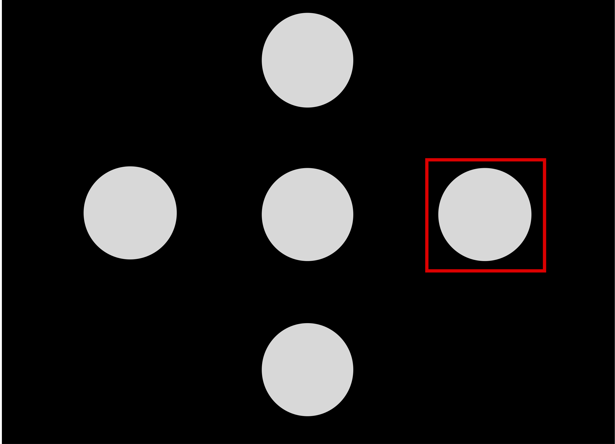
Datasets
1
Dataset:
Burst-CVEP and CVEP based EEG
12 participants
1 session each
2 modes : CVEP et Burst-CVEP
15 runs of 4 different 2,2s stimuli each
2
4
3
K. Cabrera Castillos, et al. NeuroImage, page 11, 2023.

Slide 10



Methods
Comparison between CNN and two types of SPDNet
Comparison between Domain Generalization, Domain Adaptation and Single Subject
Normalization, filtering (spatial & temporal), recentering (spatial)
Domain Generalization (DG)
Training/val data:
11 subjects
Testing data:
12th subject
Domain Adaptation (DA)
Training/val data:
11 subjects et a part of 12th subject
Testing data:
Rest of data from 12th subject
Single Subject (SS)
Training/val data:
A part of data from subject i
Testing data:
Rest of data from subject i
Notes:
Dire :
Use of MOABB for statistical analysis
Offline analysis
Framewise decoding to reconstruct the code and perform template matching
Data are normalized, spatially and temporaly filtered and spatially recentered

Slide 11
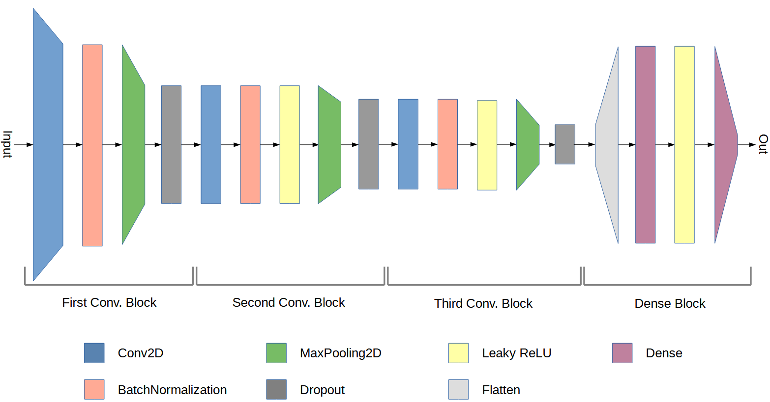
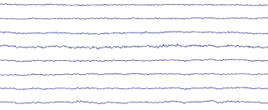

CNN
Convolutional Neural Network (CNN)
K. Cabrera Castillos, et al. NeuroImage, page 11, 2023.

Slide 12
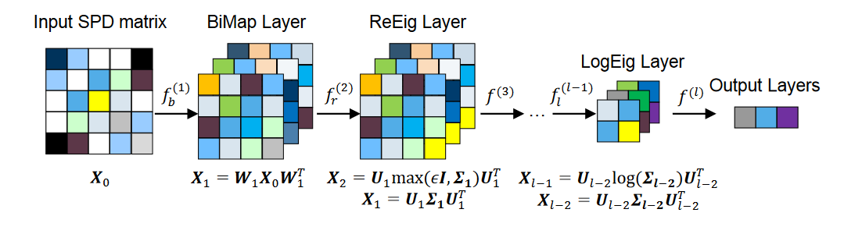
SPDNet
Covariance
transformation
Z. Huang et al. In AAAI, page 9, 2017
R. Kobler et al. In NeurIPS, 2022.

Slide 13
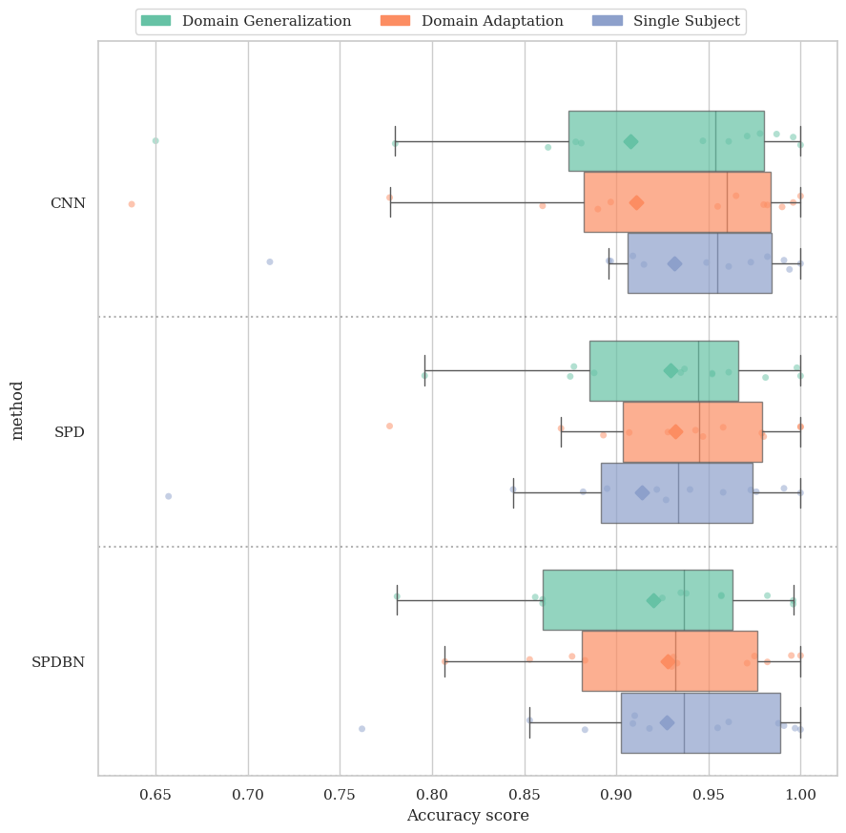
Results
DA setting performs higher than DG setting
Riemannian DeepLearning algorithms seems more consistent than CNN
Notes:
Dire:
All three models show comparable performance without significant differences (except in SS setting)
(~ 93% accuracy)
SPDBNNet is slower than SPDNet and CNN (training time: 1400s vs 130s)

Slide 14
Conclusion
In Burst-CVEP based BCI:
Domain adaptation > Domain Generalization
SPDNet on par with the CNN
SPDBNNet is too slow

Slide 15
Future direction
Usage of wavelet features to improve transferability
Train on similar subjects
Test on data of an on-going experiment to check inter-session variabilities
Notes:
Avant de parler des prochains travaux, peut-être mettre quelques ‘’take-home messages’’: - rappel de l’approche proposée & originalité
- Principales conclusions

Slide 16

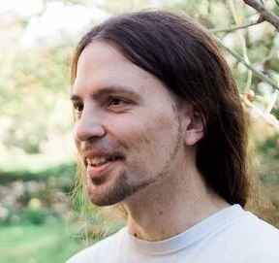
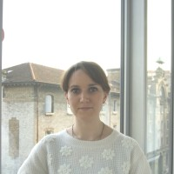
Thanks for the support
Frédéric Dehais
Sylvain Chevallier
Marie-Constance Corsi

Slide 17
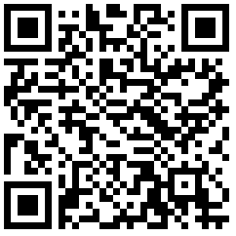
Thank you for listening !
Sebastien.velut@isae-supaero.fr
Scan for the article

